Slide 1

REAL-TIME RESEARCH PROJECT

Slide 2
TITLE:
Image Steganography with CNN Based Encoder-Decoder Model
PRESENTED BY:
UNDER THE GUIDANCE OF:
Dr Punyaban Patel
( Professor)
RISHITH KUMAR SHETTY [247R1A05B8]
GURRALA SAI SUDHA [247R1A0586]
LOKAM SHRUTHILAYA [247R1A0599]

Slide 3
INTRODUCTION:
Image Steganography is a method of hiding information within digital images to ensure secure communication. Leveraging advancements in deep learning, Convolutional Neural Networks (CNNs) are now used to create encoder-decoder models for embedding and retrieving secret messages. This approach enhances the robustness and efficiency of steganography compared to traditional methods. The CNN-based models not only allow precise encoding but also improve the quality of the decoded images.

Slide 4
EXISTING SYSTEM:
Traditional image steganography uses methods like Least Significant Bit (LSB) and Discrete Cosine Transform (DCT) to hide data in images. However, these methods have problems such as low data capacity, weak resistance to attacks, and reduced image quality. They are also less adaptable for modern secure communication needs.

Slide 5
Problems of Traditional Image Steganography
Low data hiding capacity (limited payload).
Easily affected by attacks like noise, compression, or cropping.
Image quality may decrease after embedding data.
Security is weaker and easier to detect

Slide 6
Proposed System:
The proposed system uses a Convolutional Neural Network (CNN)-based encoder–decoder model for image steganography.
The encoder hides the secret message inside the image.
The decoder extracts the hidden message from the stego image.
CNN learns image features automatically to improve embedding and extraction.
The system maintains image quality while securely hiding data.
It provides better accuracy, security, and robustness compared to traditional methods.

Slide 7
ADVANTAGES:
High payload capacity for embedding larger messages.
Enhanced robustness against various attacks and distortions.
Maintains the visual quality of the carrier image.
Increased retrieval accuracy with minimal data loss.
Adaptive to diverse datasets and dynamic requirements.

Slide 8
SYSTEM REQUIREMENTS:
HARDWARE REQUIREMENTS:
Ø System : Pentium Dual Core.
Ø Hard Disk : 120 GB.
Ø Monitor : 15’’ LED
Ø Input Devices : Keyboard, Mouse
Ø Ram : 1 GB
SOFTWARE REQUIREMENTS:
Ø Operating system : Windows 10/11.
Ø Coding Language : python
Ø Tool : pycharm
Ø Database : MYSQL
Ø framework : django

Slide 9
Novelty of the Project:
Uses deep learning instead of traditional steganography methods.
Combines Convolutional Neural Network (CNN) with an encoder–decoder architecture for better data hiding and extraction.
Maintains high image quality while embedding secret data.
Provides higher security and accuracy compared to methods like Least Significant Bit (LSB).
More robust against image distortions and attacks.

Slide 10
System Architecture:
The system architecture describes how the image steganography model works step by step using a Convolutional Neural Network (CNN) based encoder–decoder network.
Steps:
Input Image
Preprocessing
Encoder (CNN)
Stego Image Generation
Decoder (CNN)
Output Message

Slide 11
MODULES:
1.DATA CONSUMER
2.DATA PRODUCER
3.TRUSTED AUTHORITY
4.UAVCLOUDPROVIDER
5.BLOCKCHAIN
UML DIAGRAMS:
Unified Modeling Language (UML) diagrams are used to visually represent the design and structure of the system.

Slide 12
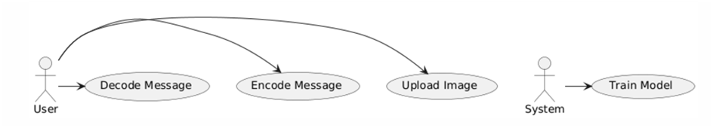
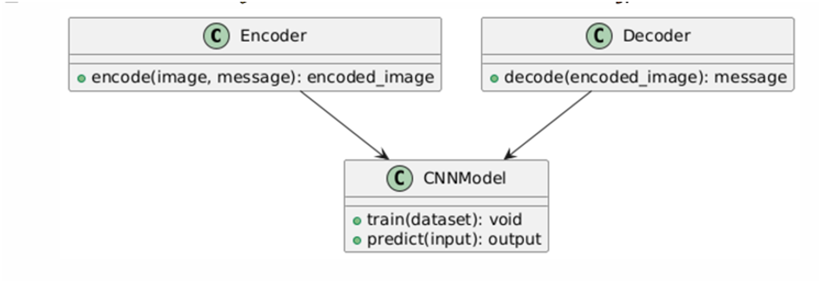
USE CASE DIAGRAM:
Shows the interaction between users and the system.
CLASS DIAGRAM:
Describes system classes, attributes, and relationships.

Slide 13
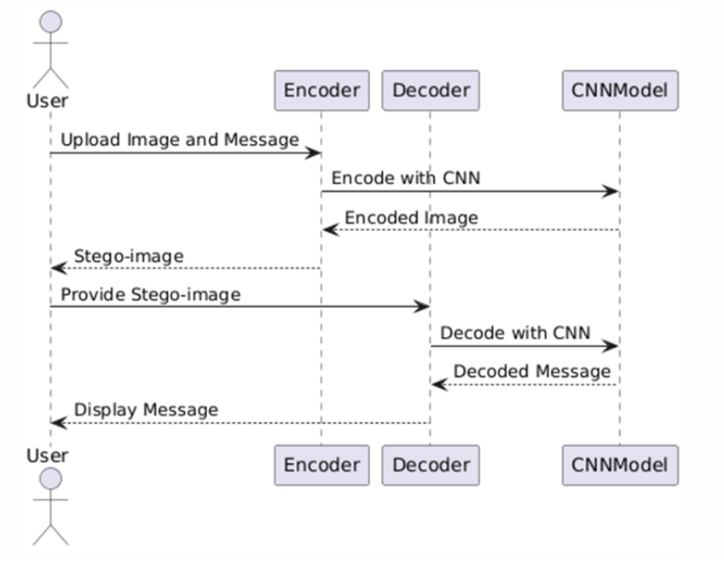
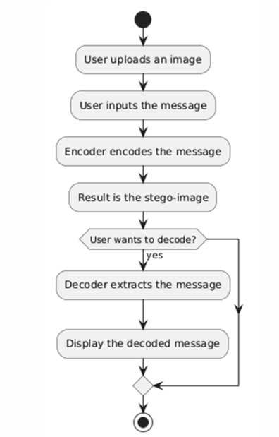
SEQUENCE DIAGRAM:
Shows the sequence of interactions between system components.
ACTIVITY DIAGRAM:
Represents the workflow of the system processes.

Slide 14
SAMPLE CODE:
views.py
from django.shortcuts import render
from django.core.files.storage import FileSystemStorage
import numpy as np
import tensorflow as tf
from tensorflow.keras.preprocessing import image
import matplotlib.pyplot as plt
import os
import cv2
from tensorflow.keras import layers, Model
# Create your views here.
def index(request):
return render(request,'index.html')
def LogAction(request):
uname=request.POST['username']
pwd=request.POST['password']
If uname == 'Admin' and pwd == 'Admin':
return render(request,'AdminHome.html')
else:
context={'msg':'Login Failed...!!'}
return render(request,'AdminApp/index.html',context)

Slide 15
def home(request):
return render(request,'AdminHome.html')
def encode(request):
return render(request,'Encode.html')
# Define the character set and mappings for one-hot encoding
char_set= 'ABCDEFGHIJKLMNOPQRSTUVWXYZabcdefghijklmnopqrstuvwxyz0123456789'
char_to_index = {char: idx for idx, char in enumerate(char_set)}
index_to_char = {idx: char for idx, char in enumerate(char_set)}
# Function to convert text to one-hot encoding
deftext_to_one_hot(text, char_to_index, text_length):
one_hot_encoded = np.zeros((text_length, len(char_to_index))) # Shape: (text_length, vocab_size)
fori, char in enumerate(text):
ifi<text_length:
index = char_to_index.get(char, -1) # Get index of the character
if index != -1:
one_hot_encoded[i, index] = 1 # Set the corresponding index to 1
returnone_hot_encoded
# Encoder Network: Embeds the secret text into the image
defbuild_encoder(input_image_shape, text_length, vocab_size):
image_input = layers.Input(shape=input_image_shape)
text_input = layers.Input(shape=(text_length, vocab_size))

Slide 16
# CNN layers to process the image
x = layers.Conv2D(32, (3, 3), activation='relu')(image_input)
x = layers.MaxPooling2D()(x)
x = layers.Conv2D(64, (3, 3), activation='relu')(x)
x = layers.MaxPooling2D()(x)
x = layers.Conv2D(128, (3, 3), activation='relu')(x)
x = layers.MaxPooling2D()(x)
x = layers.Flatten()(x)
# Concatenate the text input with the image features
x = layers.Concatenate()([x, layers.Flatten()(text_input)])
# Fully connected layer to produce the final encoded image
encoded_image = layers.Dense(np.prod(input_image_shape), activation='sigmoid')(x)
encoded_image = layers.Reshape(input_image_shape)(encoded_image)
encoder = Model(inputs=[image_input, text_input], outputs=encoded_image)
return encoder
# Decoder Network: Extracts the secret text from the image
defbuild_decoder(input_image_shape, text_length, vocab_size):
image_input = layers.Input(shape=input_image_shape)
# CNN layers to process the encoded image and extract text features
x = layers.Conv2D(128, (3, 3), activation='relu')(image_input)
x = layers.MaxPooling2D()(x)
x = layers.Conv2D(64, (3, 3), activation='relu')(x)

Slide 17
x = layers.MaxPooling2D()(x)
x = layers.Conv2D(32, (3, 3), activation='relu')(x)
x = layers.MaxPooling2D()(x)
x = layers.Flatten()(x)
decoded_text = layers.Dense(text_length * vocab_size, activation='softmax')(x)
decoded_text = layers.Reshape((text_length, vocab_size))(decoded_text)
decoder = Model(inputs=image_input, outputs=decoded_text)
return decoder
global filename, uploaded_file_url
defEncodeAction(request):
global filename, uploaded_file_url
decoded_text='null‘
if request.method == 'POST' and request.FILES['file']:
myfile = request.FILES['file']
message = request.POST['message']
iflen(message) == 20:
fs = FileSystemStorage()
location = myfile.name
filename = fs.save(myfile.name, myfile)
uploaded_file_url = fs.url(filename)
BASE_DIR = os.path.dirname(os.path.dirname(os.path.abspath(__file__)))
imagedisplay = cv2.imread(BASE_DIR + "/" + uploaded_file_url)

Slide 18
uploaded_file_url = fs.url(filename)
BASE_DIR = os.path.dirname(os.path.dirname(os.path.abspath(__file__)))
imagedisplay = cv2.imread(BASE_DIR + "/" + uploaded_file_url)
# Load an image from your system (ensure the path is correct)
#image_path = myfile # Replace with the actual path to your image
img = image.load_img(BASE_DIR + "/" + uploaded_file_url, target_size=(32, 32))
# Resize to 128x128
img_array = image.img_to_array(img) # Convert image to numpy array
# Normalize the image to [0, 1]
img_array = img_array / 255.0
# Display the image
plt.imshow(img_array)
plt.title('Uploaded Image')
plt.show()
plt.close()
print("Image Shape:", img_array.shape)
# Example secret text and text length
secret_text = message
text_length = 20 # Maximum length of the secret text
encoded_text = text_to_one_hot(secret_text, char_to_index, text_length)
print("Encoded Text Shape:", encoded_text.shape)

Slide 19
# Define input image shape
input_image_shape = (32, 32, 3)
# Build encoder and decoder
encoder = build_encoder(input_image_shape, text_length, len(char_to_index))
decoder = build_decoder(input_image_shape, text_length, len(char_to_index))
# Define the full model (encoder + decoder)
encoded_image = encoder.output
decoded_text = decoder(encoded_image)
full_model = Model(inputs=[encoder.input[0], encoder.input[1]], outputs=decoded_text)
full_model.compile(optimizer='adam', loss='categorical_crossentropy', metrics=['accuracy'])
full_model.summary()
# Prepare the image and text for training
train_images = np.expand_dims(img_array, axis=0) # Add batch dimension
train_texts = np.expand_dims(encoded_text, axis=0) # Add batch dimension
# Train the full model
full_model.fit([train_images, train_texts], train_texts, epochs=25, batch_size=1)
# Save the model for future use
full_model.save('encoder_decoder_model.h5')
# Test the model with a new image and secret text
test_image = np.expand_dims(img_array, axis=0) # Use the same test image
test_text = np.expand_dims(encoded_text, axis=0) # Use the same secret text

Slide 20
# Encode the secret text into the image
encoded_test_image = encoder.predict([test_image, test_text])
# Remove the batch dimension by squeezing it (assuming only one image in the batch)
img_single = encoded_test_image[0]
# Or use img_array.squeeze() if you want to squeeze all dimensions
# Display the image
plt.imshow(img_single)# img_single will have shape (32, 32, 3)
plt.title('Steganography Image')
plt.axis('off') # Hide axis for clarity
plt.savefig('Stegano_image.png', bbox_inches='tight', pad_inches=0)
plt.show()
plt.close()
# Decode the text from the encoded image
decoded_text_from_image = decoder.predict(encoded_test_image)
# Convert the decoded output (one-hot encoding) back to text
decoded_text_from_image = np.argmax(decoded_text_from_image, axis=-1) # Get the indices
decoded_text = ''.join([index_to_char[idx] for idx in decoded_text_from_image[0]])
print("Decoded Text:", decoded_text)
context = {'data': decoded_text}
return render(request,'Decode.html', context)
else:context = {'data': "Message Length Must Be 20 Characters"}
return render(request,'Encode.html', context)

Slide 21
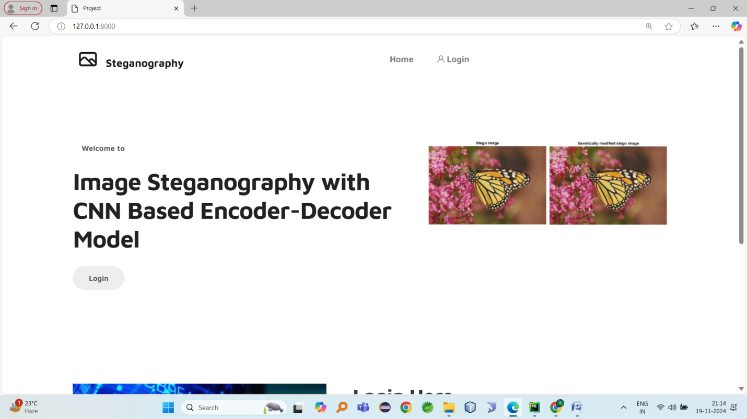
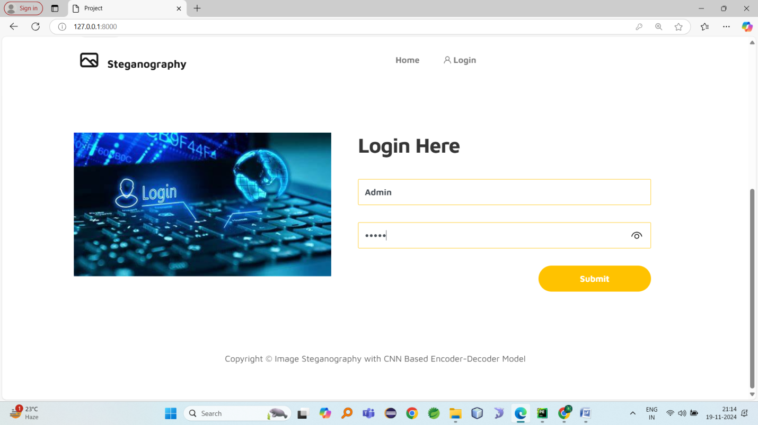
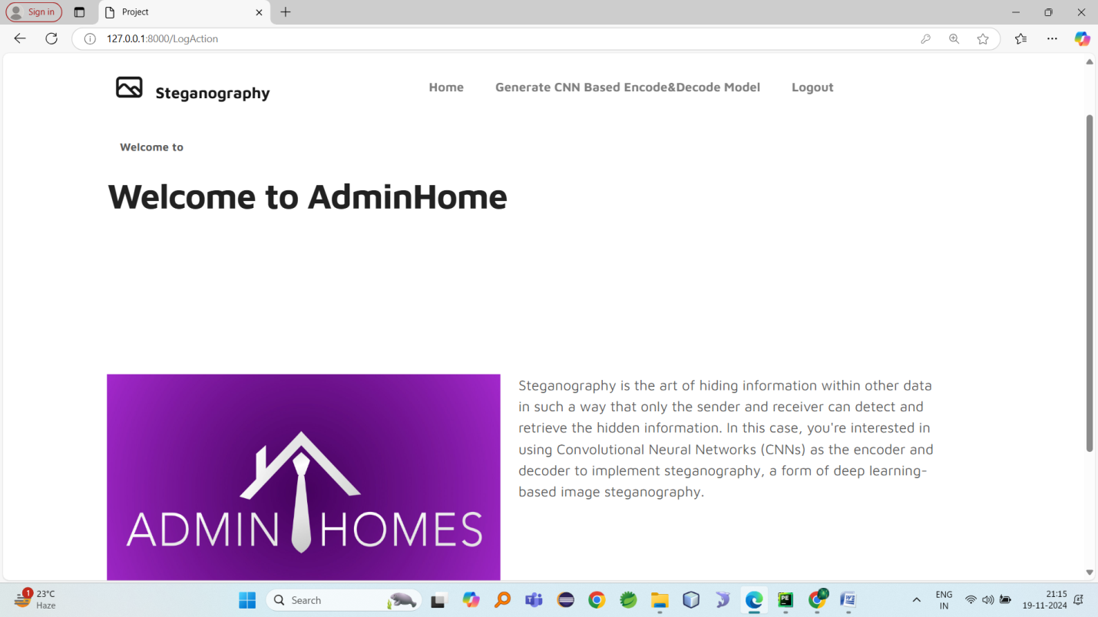
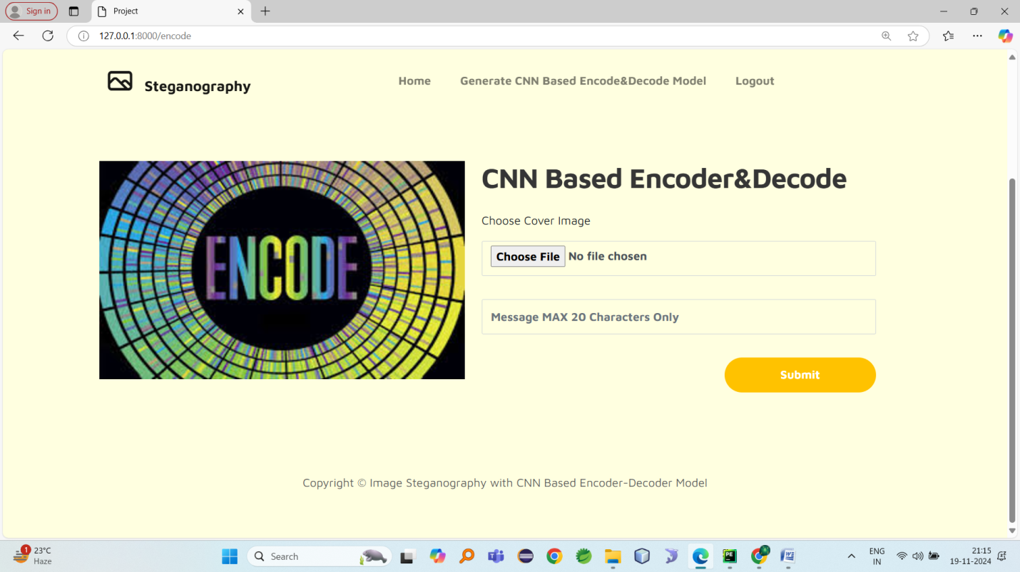
Result:

Slide 22
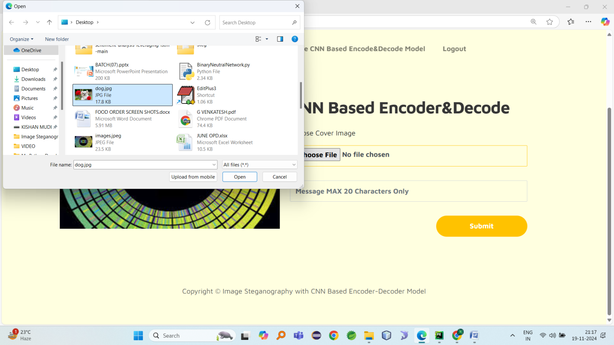
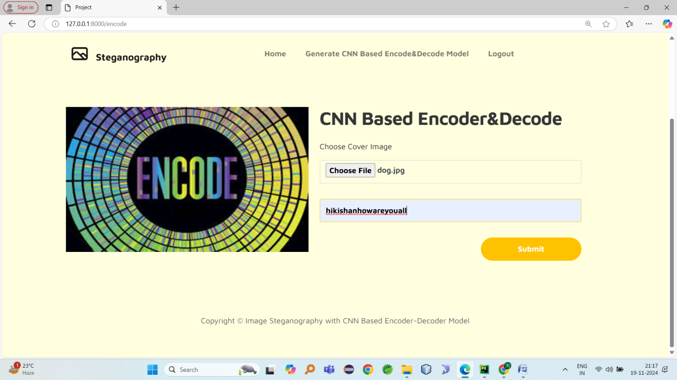
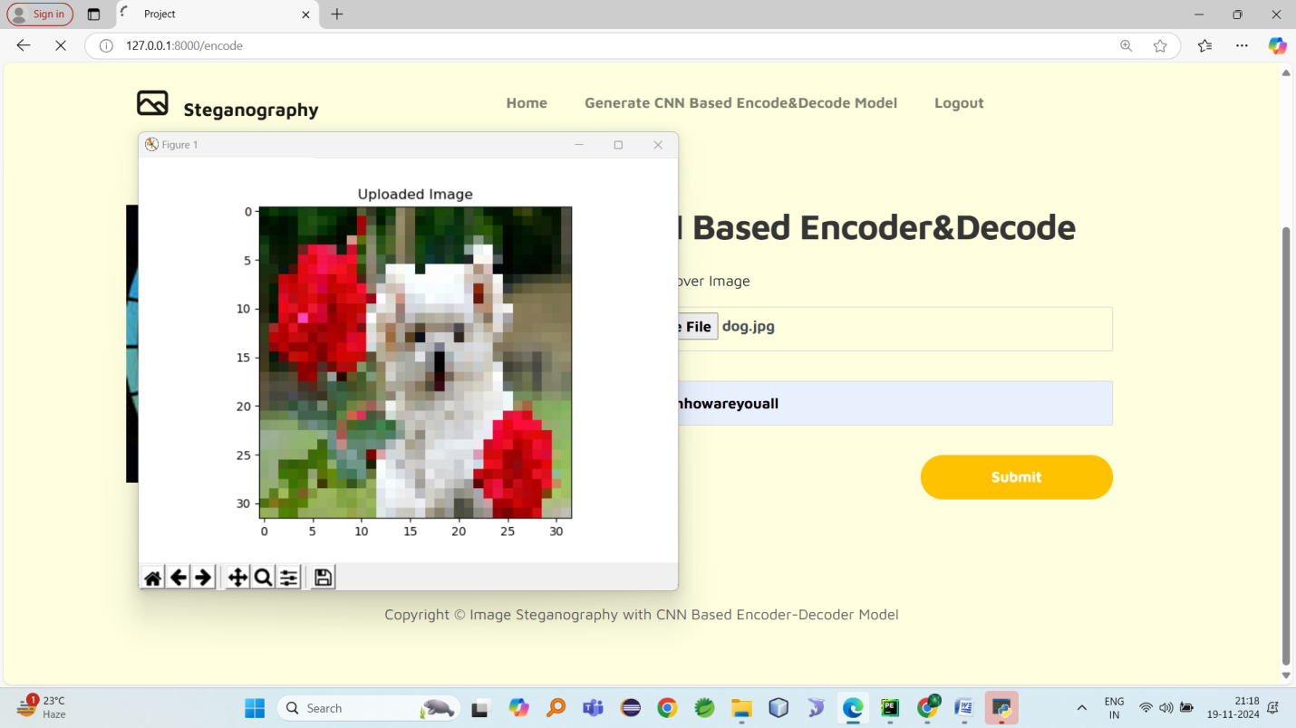
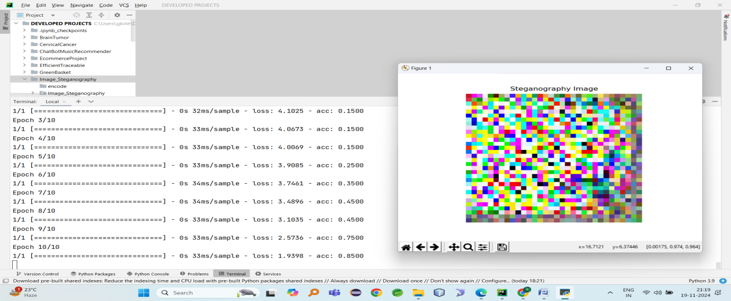

Slide 23
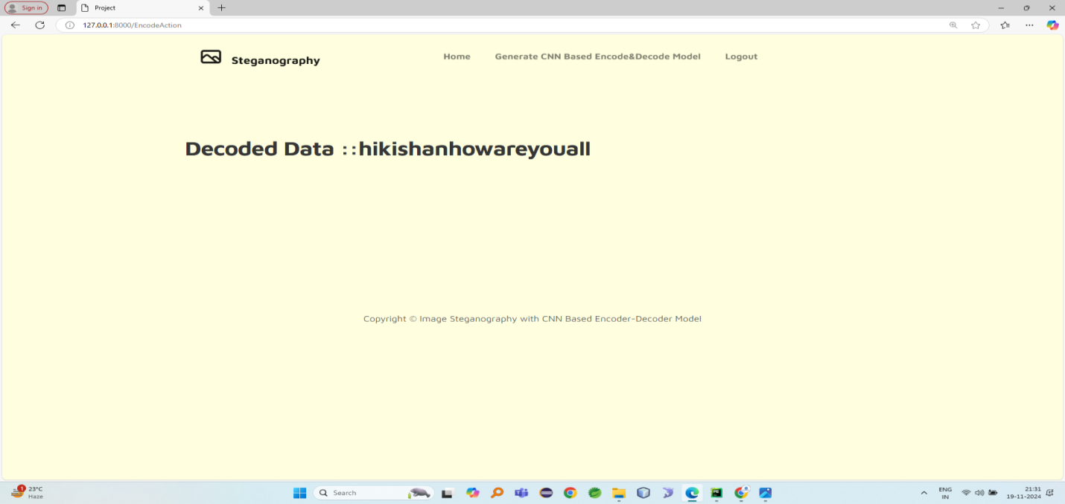
Conclusion:
The proposed image steganography system uses a Convolutional Neural Network (CNN) based encoder–decoder model to hide and retrieve secret data in images. It improves security, payload capacity, and image quality compared to traditional methods like Least Significant Bit (LSB). The system successfully hides data and retrieves it with high accuracy, making it useful for secure communication and digital forensics.

Slide 24
FUTURE ASPECTS:
Future research can focus on enhancing the model performance, improving robustness, and extending the system for more advanced applications.
Future work can also include the development of real-time steganography systems for secure communication over the internet and multimedia platforms. Additionally, lightweight deep learning architectures can be implemented to enable the system to run efficiently on mobile devices, embedded systems, and IoT platforms.

Slide 25
REFERENCES:
[1] Zhu, J., Kaplan, R., Johnson, J., &Fei-Fei, L. (2018). "Image Steganography Using
Deep Convolutional Neural Networks."
[2] Baluja, H. (2019). "Deep Learning-Based Steganography and Steganalysis."
[3] Kumar, A., &Tripathi, S. (2020). "Secure Image Steganography with GANs and
CNNs."
[4] Patel, K., & Mishra, V. (2021). "A Deep Learning Framework for Image
Steganography Using CNN."
[5] Zhang, M., Li, Y., & Zhou, X. (2022). "Robust Image Steganography with Encoder-
Decoder Networks."
GITHUB LINK:
https://github.com/shettyrishit-1707/IMAGE-STEGANOGRAPHY-

Slide 26
THANK YOU
~
~

